Slide 1
Unpacking Assessment Criteria
Modern History
Stage 2
Malcolm Massie
Head of Humanities
Scotch College
Vice President
HTASA
mmassie@scotch.sa.edu.au

Slide 2
Understanding and Exploration
UE1 Understanding and exploration of historical concepts.
UE2 Understanding and exploration of the role of ideas, people, and events in history.
Application and Evaluation
AE1 Application of the skills of historical inquiry to examine and evaluate sources and interpretations.
AE2 Interpretation and synthesis of evidence to support arguments and draw conclusions.
AE3 Communication of reasoned historical arguments, with appropriate acknowledgment of sources.
Analysis
A1 Analysis of ways in which the development of the modern world has been shaped by both internal and external forces and challenges.
A2 Analysis of interactions and relationships in the modern world, and their short-term and long-term impacts on national, regional, and/or international development.

Slide 3
Understanding and Exploration
UE1 Understanding and exploration of historical concepts.
UE2 Understanding and exploration of the role of ideas, people, and events in history.
Application and Evaluation
AE1 Application of the skills of historical inquiry to examine and evaluate sources and interpretations.
AE2 Interpretation and synthesis of evidence to support arguments and draw conclusions.
AE3 Communication of reasoned historical arguments, with appropriate acknowledgment of sources.
Analysis
A1 Analysis of ways in which the development of the modern world has been shaped by both internal and external forces and challenges.
A2 Analysis of interactions and relationships in the modern world, and their short-term and long-term impacts on national, regional, and/or international development.
“The set of assessments as a whole, must give students opportunities to demonstrate each of the specific features by the completion of the study of the subject”

Slide 4
Understanding and Exploration
UE1 Understanding and exploration of historical concepts.
UE2 Understanding and exploration of the role of ideas, people, and events in history.
Application and Evaluation
AE1 Application of the skills of historical inquiry to examine and evaluate sources and interpretations.
AE2 Interpretation and synthesis of evidence to support arguments and draw conclusions.
AE3 Communication of reasoned historical arguments, with appropriate acknowledgment of sources.
Analysis
A1 Analysis of ways in which the development of the modern world has been shaped by both internal and external forces and challenges.
A2 Analysis of interactions and relationships in the modern world, and their short-term and long-term impacts on national, regional, and/or international development.
Strongly suggest that you do not attempt to assess more than 3 per historical skills assessment task.

Slide 5
Understanding and Exploration
UE1 Understanding and exploration of historical concepts.

Slide 6
Understanding and Exploration
UE1 Understanding and exploration of historical concepts.
Change
Continuity
Significance
Contestability
Cause and Effect
Political , Economic, Social, Cultural

Slide 7
Understanding and Exploration
UE1 Understanding and exploration of historical concepts.
and

Slide 8
Understanding and Exploration
UE1 Understanding and exploration of historical concepts.
I understand the concept and have used it to describe/compare/ contrast/evaluate/distinguish between/separate/group something in my case study.

Slide 9
Understanding and Exploration
UE2 Understanding and exploration of the role of ideas, people, and events in history.

Slide 10
Understanding and Exploration
UE2 Understanding and exploration of the role of ideas, people, and events in history.
Impact of influential ideas.

Slide 11
Understanding and Exploration
UE2 Understanding and exploration of the role of ideas, people, and events in history.
Impact of influential ideas.

Slide 12
Understanding and Exploration
UE2 Understanding and exploration of the role of ideas, people, and events in history.
Could be individuals, groups, nations, followers of the same religion/political philosophy.

Slide 13
Understanding and Exploration
UE2 Understanding and exploration of the role of ideas, people, and events in history.
“Event”
Meeting, interview, journey, protest, war, genocide ……

Slide 14
.
Application and Evaluation
AE1 Application of the skills of historical inquiry to examine and evaluate sources and interpretations.
Ask an appropriate question.
Frame research parameters.
Locate and read sources.
Answer the question. .

Slide 15
.
Application and Evaluation
AE1 Application of the skills of historical inquiry to examine and evaluate sources and interpretations.
Identify the genre, bias, reliability and usefulness/limitations. .

Slide 16
.
Application and Evaluation
AE1 Application of the skills of historical inquiry to examine and evaluate sources and interpretations.
Give reasons why they are either useful or not. .

Slide 17
.
Application and Evaluation
AE1 Application of the skills of historical inquiry to examine and evaluate sources and interpretations.
and
Primary sources and secondary interpretations. .

Slide 18
.
Application and Evaluation
AE1 Application of the skills of historical inquiry to examine and evaluate sources and interpretations.
Secondary interpretations.
May be historians but may be views of groups, newspapers, collective memory.….. .

Slide 19
.
Application and Evaluation
AE2 Interpretation and synthesis of evidence to support arguments and draw conclusions.
A valid interpretation of evidence.

Slide 20
.
Application and Evaluation
AE2 Interpretation and synthesis of evidence to support arguments and draw conclusions.
Grouping evidence to make a case.

Slide 21
.
Application and Evaluation
AE2 Interpretation and synthesis of evidence to support arguments and draw conclusions.
It may be the argument made by a student, or that of a historian, or of a historical figure. “This line of argument leads me to this conclusion”.

Slide 22
.
Application and Evaluation
AE3 Communication of reasoned historical arguments, with appropriate acknowledgment of sources.
Clear, appropriately styled in whatever form of communication has been negotiated.

Slide 23
.
Application and Evaluation
AE3 Communication of reasoned historical arguments, with appropriate acknowledgment of sources.
Clear, appropriately styled in whatever form of communication has been negotiated.
Be sensitive to different conventions for different genres.

Slide 24
.
Application and Evaluation
AE3 Communication of reasoned historical arguments, with appropriate acknowledgment of sources.
Argument and counter argument.

Slide 25
.
Application and Evaluation
AE3 Communication of reasoned historical arguments, with appropriate acknowledgment of sources.
Appropriate to the genre which has been negotiated.

Slide 26
.
Application and Evaluation
AE3 Communication of reasoned historical arguments, with appropriate acknowledgment of sources.
Appropriate to the genre which has been negotiated.
Suggest at least one use of traditional referencing.

Slide 27
Analysis
A1 Analysis of ways in which the development of the modern world has been shaped by both internal and external forces and challenges.
Significant change due to …
Must make a connection between a force or challenge and an influential change.

Slide 28
Analysis
A1 Analysis of ways in which the development of the modern world has been shaped by both internal and external forces and challenges.
Must cover BOTH. Assess this when your case study allows for easy demonstration of both.

Slide 29
Analysis
A2 Analysis of interactions and relationships in the modern world, and their short-term and long-term impacts on national, regional, and/or international development.
Wars, trade, culture, migration…

Slide 30
Analysis
A2 Analysis of interactions and relationships in the modern world, and their short-term and long-term impacts on national, regional, and/or international development.
Formal (eg NATO)
Informal (shared religion)

Slide 31
Analysis
A2 Analysis of interactions and relationships in the modern world, and their short-term and long-term impacts on national, regional, and/or international development.
Need both over the course of the year.

Slide 32
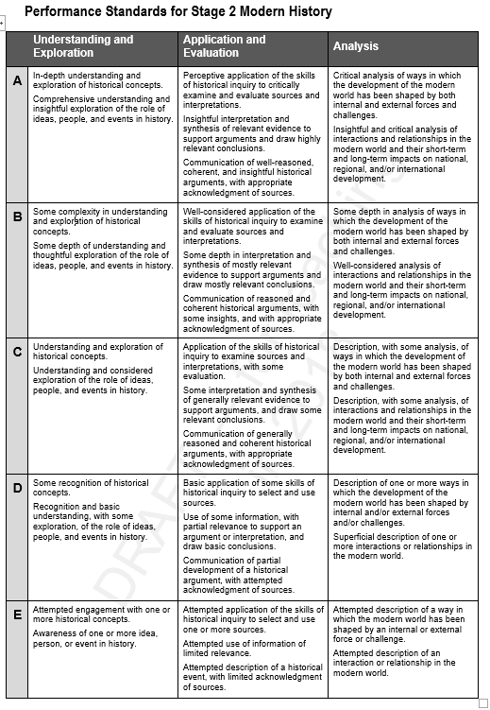
Language of the performance standards.

Slide 33
A:
In-depth
Comprehensive
Perceptive
Insightful
Critical.

Slide 34
B:
Some depth
Some complexity
Thoughtful
Well considered
Reasoned and coherent

Slide 35
C:
Understanding
Some interpretation
Generally reasons and coherent
Description with some analysis

Slide 36
D:
Some recognition
Basic Understanding
Basic application
Partial relevance
Partial development.

Slide 37
E:
Attempted engagement
Attempted application
Attempted use
Attempted description

